Slide 1
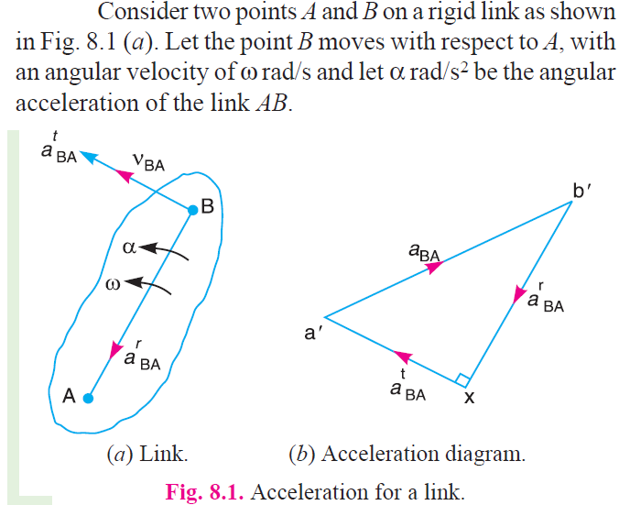
Theory of machines Wessam Al Azzawi
Mechanism:
Acceleration Diagram for a Link

Slide 2
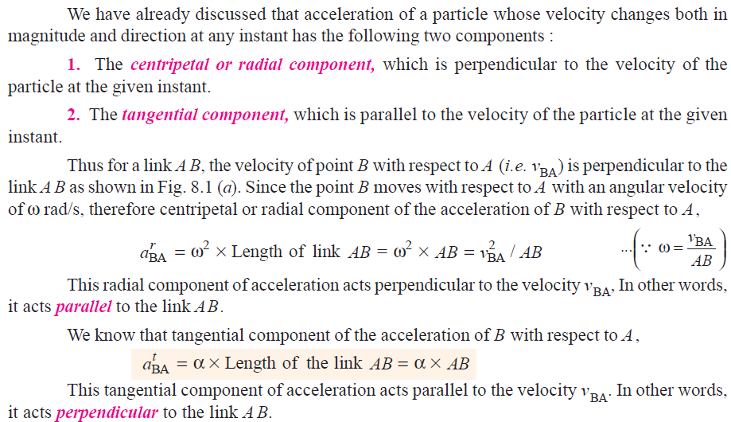
Theory of machines Wessam Al Azzawi
Mechanism:
Acceleration Diagram for a Link

Slide 3
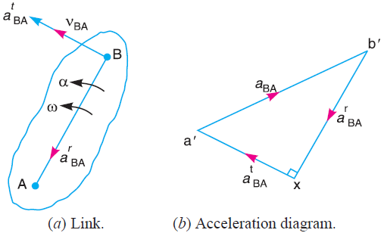
Theory of machines Wessam Al Azzawi
Mechanism:

Slide 4
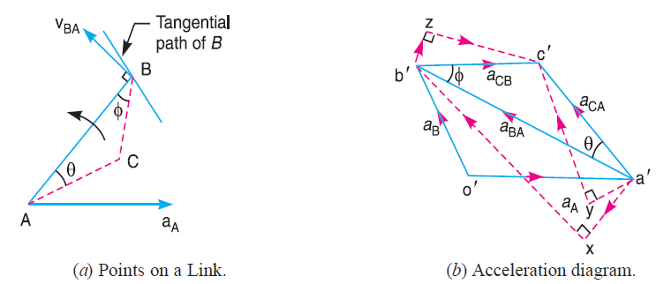
Theory of machines Wessam Al Azzawi
Mechanism:
Acceleration of a Point on a Link

Slide 5
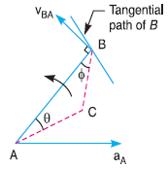
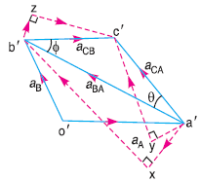
Theory of machines Wessam Al Azzawi
Mechanism:
We know that the acceleration of B with respect to A i.e. a_{BA} has the following two components:
Radial component of the acceleration of B with respect to A i.e. a^{r}_{AB}
Tangential component of the acceleration B with respect to A i.e. a^{t}_{AB}. These two components are mutually perpendicular.
Draw vector a'x parallel to the link AB (because radial component of the acceleration of B with respect to A will pass through AB), such that
From point x, draw vector xb‘ perpendicular to AB or vector a'x (because tangential component of B with respect to A i.e. a^{t}_{BA} , is perpendicular to radial component a^{r}_{BA}) and through o' draw a line parallel to the path of B to represent the absolute acceleration of B i.e. a_{B}. The vectors xb' and o' b' intersect at b'. Now the values of a_{B} and a^{t}_{BA} may be measured, to the scale.
By joining the points a' and b' we may determine the total acceleration of B with respect to A i.e. a_{BA}. The vector a' b' is known as acceleration image of the link AB.

Slide 6
Theory of machines Wessam Al Azzawi
Mechanism:
For any other point C on the link, draw triangle a' b' c' similar to triangle ABC. Now vector b' c' represents the acceleration of C with respect to B i.e. a_{CB}, and vector a' c' represents the acceleration of C with respect to A i.e. a_{CA}. As discussed above, a_{CB} and a_{CA} will each have two components as follows :
a_{CB} has two components; a^{r}_{CB} and at_{CB} as shown by triangle b' zc' in Fig. (b), in which b' z is parallel to BC and zc' is perpendicular to b'z or BC.
a_{CA} has two components ; a^{r}_{CA} and a^{t} _{CA} as shown by triangle a' yc' in Fig. (b), in which a' y is parallel to AC and yc' is perpendicular to a' y or AC.
The angular acceleration of the link AB is obtained by dividing the tangential components of the acceleration of B with respect to A (a^{t}_{BA} ) to the length of the link. Mathematically, angular acceleration of the link AB,

Slide 7
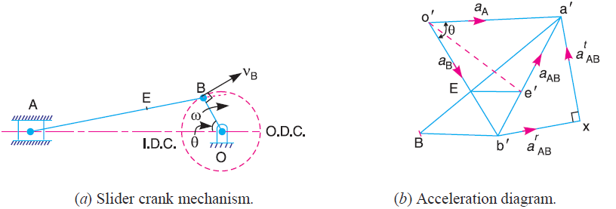
Theory of machines Wessam Al Azzawi
Mechanism:
Acceleration in the Slider Crank Mechanism
A slider crank mechanism is shown in Fig, Let the crank OB makes an angle θ with the inner dead centre (I.D.C) and rotates in a clockwise direction about the fixed point O with uniform angular velocity ω_{BO} rad/s.
∴ Velocity of B with respect to O or velocity of B (because O is a fixed point),

Slide 8
Theory of machines Wessam Al Azzawi
Mechanism:
The acceleration diagram, as shown in Fig.(b), may now be drawn as discussed below:

Slide 9
Theory of machines Wessam Al Azzawi
Mechanism:

Slide 10
Theory of machines Wessam Al Azzawi
Mechanism:

Slide 11
Theory of machines Wessam Al Azzawi
Mechanism:

Slide 12
Theory of machines Wessam Al Azzawi
Mechanism:
Draw vector ob perpendicular to BO, to some suitable scale, to represent the velocity of B with respect to O or simply velocity of B i.e. v_{BO} or v_{B}, such that
From point b, draw ba perpendicular to BA to represent the velocity of A with respect to B i.e. v_{AB} , and from point o draw vector oa parallel to the motion of A to represent the velocity of A i.e. v_{A}. The vectors ba and oa intersect at a.

Slide 13
Theory of machines Wessam Al Azzawi
Mechanism:
In order to find the velocity of the midpoint D of the connecting rod AB, divide the vector ba at d in the same ratio as D divides AB
Join od. Now the vector od represents the velocity of the midpoint D of i.e. v_{D}.
By measurement, we find that v_{D} = vector od = 4.1 m/s Ans.

Slide 14
Theory of machines Wessam Al Azzawi
Mechanism:
We know that the radial component of the acceleration of B with respect to O or the
acceleration of B,

Slide 15
Theory of machines Wessam Al Azzawi
Mechanism:

Slide 16
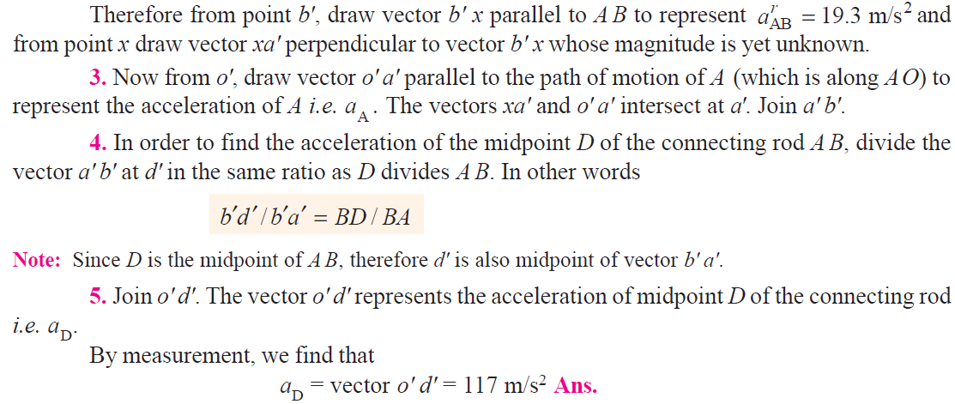
Theory of machines Wessam Al Azzawi
Mechanism:

Slide 17
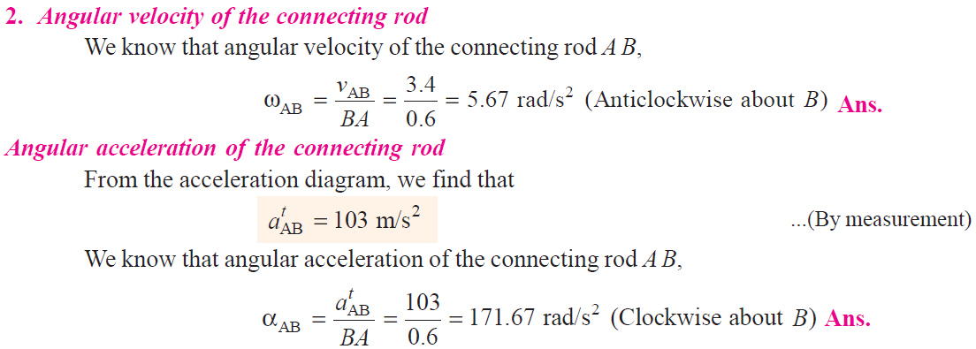
Theory of machines Wessam Al Azzawi
Mechanism:

Slide 18
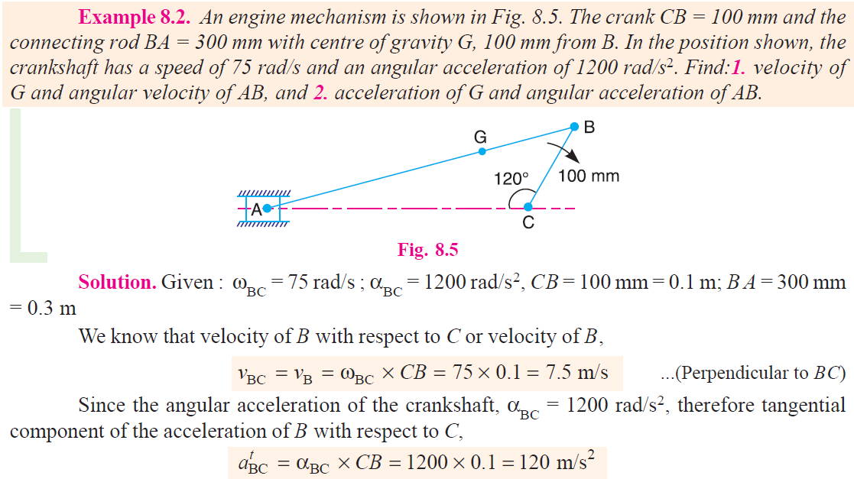
Theory of machines Wessam Al Azzawi
Mechanism:

Slide 19
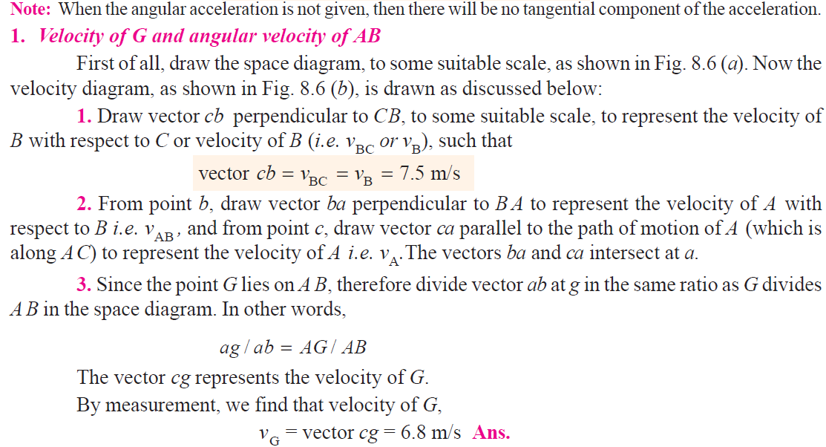
Theory of machines Wessam Al Azzawi
Mechanism:

Slide 20
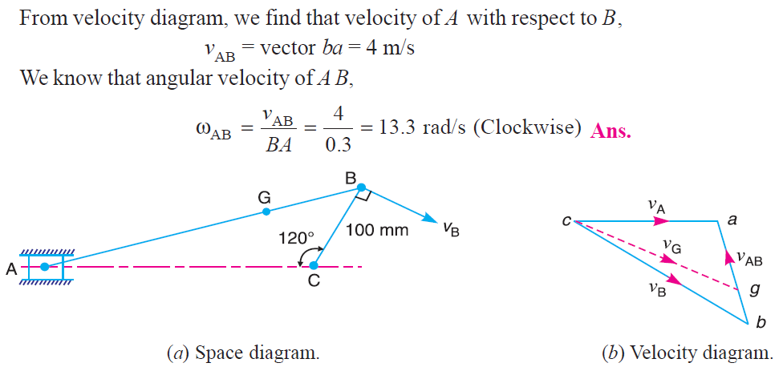
Theory of machines Wessam Al Azzawi
Mechanism:

Slide 21
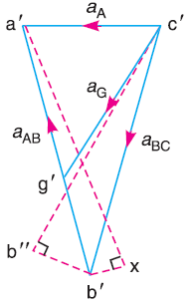
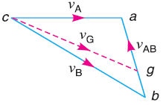
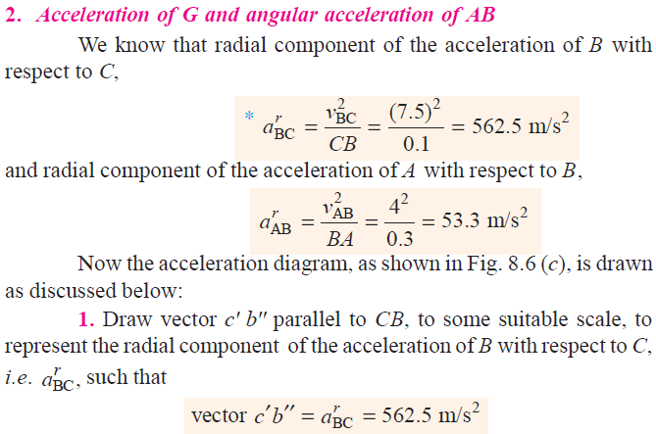
Theory of machines Wessam Al Azzawi
Mechanism:

Slide 22
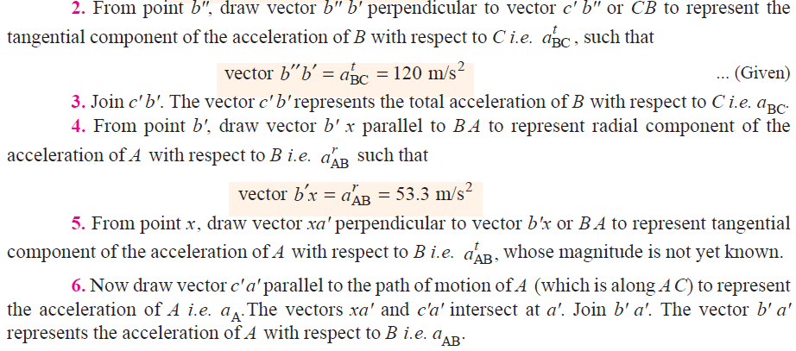
Theory of machines Wessam Al Azzawi
Mechanism:

Slide 23
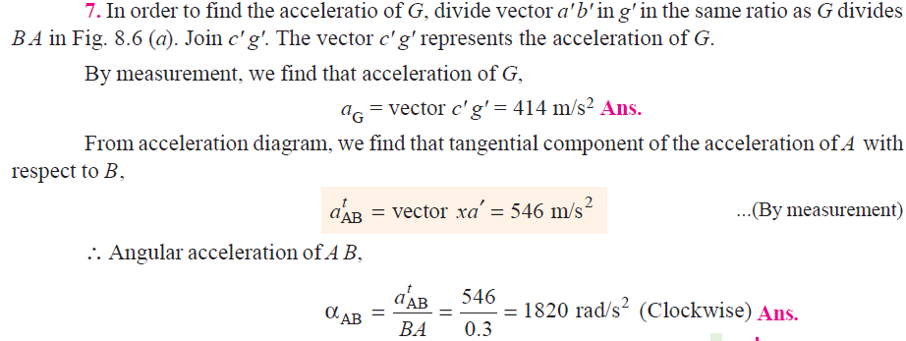
Theory of machines Wessam Al Azzawi
Mechanism:

